Slide 1
ANCBH New Member Discussions
New member(s): Jerry McKee
Trainers: Jean Douglas & Eva Brown
Date(s): August, 2025

Slide 2
Agenda
ANCBH mission, purposes, and brief history of the organization
Advocacy
Member categories, Review of current member specialties and roles, including our Executive Director and Program Consultant
Meetings
Member communication and communication strategies
Networking and visibility
Finances
Partnerships
Awards
Current and past projects and initiatives
Q&A

Slide 3

ANCBH Website
https://www.ancbh.org/

Slide 4
ANCBH Mission, Purposes, and Brief History of the Organization
Incorporated in 1986.
Goal: To pursue excellence in public health in North Carolina by providing leadership and support for local Boards of Health in their efforts to protect and promote the public's health. And its purposes remain focused on the health of the public by:
    Promoting for the citizens of North Carolina. high standards of comprehensive public health services
    Providing consultation and education for, and facilitate the exchange of ideas among, Board of Health members.
    Supporting health policy and finance issues in support of public health in North Carolina.
    Promoting close working relationships between local Boards of Health and other allied agencies.
    Promoting programs and projects deemed necessary to protect and promote the health of the citizens in North Carolina.
    Supporting public awareness of public health issues and dangers.

Slide 5
Advocacy
Most important book on this topic was written by a past member of ANCBH, Dr. Robert R. Blackburn. Note: This also has application to education.
  Advocacy from A to Z
Advocacy efforts can involve supporting other public health agencies’ position statements, as well as development of our own statements. Letters of support have been written in support of disciplines to improve services to our citizens, and also for recommending persons for awards in the public health arena.
Advocacy is educating on an idea or service. Lobbying is suggesting a legislator vote for your idea/program.
Our goal is to help members of BOHs to better advocate for public health to their county commissioners.

Slide 6
NC Board of Health Models
Traditional Board of Health in each county
  45 local boards of health
  Membership defined in NC Statutes GS 130 A-34 with specific disciplines
Consolidated Human Services Agency
  2012; GS 130A-34; 130A-43; 153A-77
  Several human services departments joined with one consolidated Director
  Commissioners serve as BOH
    Advisory Committee required
  31 consolidated boards of health
District Health Department (multicounty)
  2 or more counties
  GS 130A-34
  8 districts
Public Health Authority and Public Hospital Authority
  GS 130A-45 to 130A-45.13
  Cabarrus – Public Hospital Authority
  Mecklenburg – Public Health Authority

Slide 7
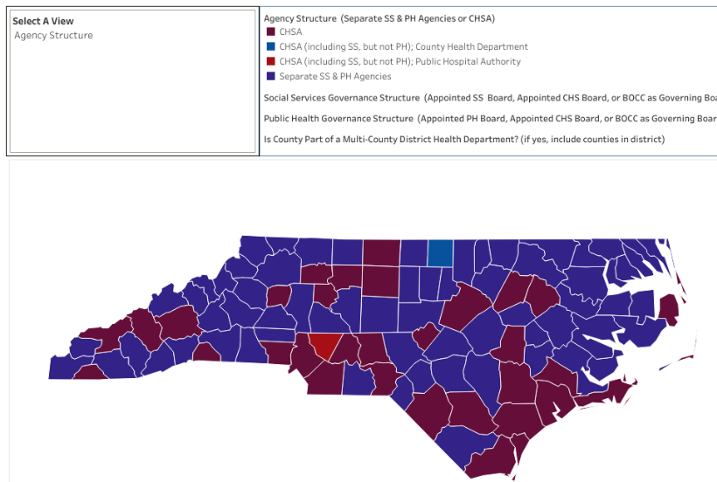
North Carolina Boards of Health

Slide 8
Member Categories
Institutional
  Counties who pay their dues; may vote at the Annual Meeting and nominate officers for the organization.
Individual
  Current members of local Boards of Health (have been sworn-in to serve on their BOH).
Associate
  Past sworn-in member of a BOH or a liaison to a public health organization who support the goals of ANCBH and has a passion for public health.
Emeritus Director
  An honor awarded to a past officer of the organization for continued excellence and service. Has voting privileges and has lifetime membership to serve as desired.

Slide 9
Review of Current Member Specialties and Roles
Jean Douglas: Past President and Pharmacist (Guilford County)
Ben Tillett: President and Pharmacist (Person County)
Edna Hensey: Treasurer and Citizens for Public Health liaison (Wake County)
Barbara Ann Hughes: Director Emeritus, past president and Dietician (Wake)
Deborah Fortune: Assistant Professor, Public Health Education at NCCU (Durham)
John Kessler: ANCBH webmaster, and Pharmacist (Chatham)
Herbert Garrison: Physician Chair of BOH and Associate Dean Continuing Education (Pitt)

Slide 10
Review of Current Member Specialties and Roles, continued
Eva Brown: Past secretary, Assistant Director Health Department, public health advocate (diabetes), Nursing Home Consultant, and BOH member (Warren)
Janet Clayton: Health Director and liaison from the NC Association of Local Health Directors (Person)
Marielena Moreno-Garcia: Liaison to NCLHD Accreditation Board, NALBOH Board of Directors, nurse, and BOH Chair, member (Alamance)
Calvert Jeffers: Past ANCBH President and veterinarian BOH (Forsyth)
Karl Johnson: Assistant Professor and Liaison from UNC Gillings SOPH (Durham)
Eddie Jordan: Past Chair of Surry County Board of Health (Surry)
Kevin Austin: Past Chair of Yadkin County Commissioners, engineer (Yadkin)
Pam Andrews: current chair of AppHealthcare District Board of Health and mental health counselor (Allegany, Ashe and Watauga)
Jerry McKee: Past member of Burke County BOH and mental health pharmacist (Burke)

Slide 11
Executive Director
Merle Green, MBA, MPH
30 hours/week
Represents ANCBH at meetings and attends the Health Director’s monthly meetings.
Attends each of the 10 regional zones as scheduled.
Past Health Director of Guilford County.
Knowledgeable in public health in state and knows many key persons.
Office located at Alamance Health Department in Burlington (4th floor, mgreen@alamance-countync.gov)
Responds to questions from calls, meetings, website, etc. concerning policies and conflicts.
Leads activities and works with board members on an on-going basis.
Supervises our Program Consultant (ashley.curtice9@gmail.com)

Slide 12
Meetings
Members selected the following time for our meetings this year:
  Every other month (odd numbered months)
  Every third Wednesday of the scheduled month
  9am (with 10a hard stop)
  Zoom
Governance Network Zooms are provided
  Every other month (even numbered months), Monday evening in scheduled month at 7pm with a hard stop at 8pm.
An Annual Meeting is required per the Bylaws. The purpose is to vote on officers, present our awards, and update the Bylaws. Institutional members are invited to participate and vote at this meeting.
A Whole Year Calendar is maintained by the Executive Committee so members will know when meetings occur and the status of projects. This is updated monthly.

Slide 13
Member Communication
Agenda is emailed at least a week before the scheduled meeting, including attachments. Late minute documents may be emailed out before the meeting.
Minutes will be emailed after the meeting with the required follow-up defined. Attachments will be included also. Approval will be voted upon at the next meeting.
Decisions can be made by email if needed to be made between meetings. Members email their vote.
Goals are agreed upon and worked on throughout the year. Committee Reports are presented at meetings as needed, i.e., Finance, Bylaws, Governance Network, Executive, Nomination/Awards, Program/Newsletter, Training, Accreditation, and NALBOH.

Slide 14
Communication Strategies
Newsletter:
  Format and production strategies are being tested to see what works best. Our last newsletter was well received.
  The newsletter focuses on current topics, meetings, situational problem solving from across the state, advocacy efforts, etc. Our Executive Director and Leadership Team identify articles for the newsletters.
  Our members may be asked to contribute short articles based upon their specialties and communications with local BOH members across the state.
Website:
  News and interesting information are posted to our website as needed. Please refer interested persons to this website. It is well designed.
  Share any ideas that you have for the website with John Kessler, PharmD.

Slide 15
Networking and Visibility
Send ANCBH board members to NALBOH annual meetings and NCPHA theme specific meetings (leadership, data management, education, etc.)
Send Executive Director to NALBOH and NACCHO national conferences.
When funds are available, provide scholarships for ANCBH board members and institutional members to attend conferences.
Meet with local legislators in Raleigh to address key public health issues
Advocate for public health on Hill Day in Washington, DC

Slide 16
Finances
In July of each year, each county is asked to pay registration dues to ANCBH. $400 per year. We expect 90%+ renewal rate each year.
  (Districts pay one fee only).
Fundraising efforts include continuing education programs, sponsorships for exhibiting at meetings, grant writing for small projects, etc. Ideas such as working with NC Association of County Commissioners to seek funding support for accreditation and our organization.
The Finance Committee prepares the budget and approves any activity where funds are required, such as registration program BetterUnite®. The budget is written to spend interest each year, protecting our principal.

Slide 17
Partnerships
ANCBH continues to meet the needs of our members by working with:
NCALHD: Local health directors by attending their monthly meetings, supporting their advocacy efforts, and giving a monthly report of our activities;
The N.C. Institute of Public Health local board of health training program by providing a trainer and providing input on subject matter;
The N.C. Local Health Department Accreditation Board with our four members serving on the board (one as chair, two as subcommittee chairs and one on the appeals committee;
Liaison groups such as N.C. Association of County Commissioners, N.C. Alliance for Health, NCPHA, and the N.C. Citizens for Public Health.
Bylaws can be found on our website (ancbh.org).

Slide 18
Annual Awards
Outstanding Board of Health Award
  BOH is an institutional member that has shown leadership in public health accomplishments.
Robert “Ed” Strother Partnership Award
  Individual or institution that has established and/or fostered a public-private partnership that has improved public health for their community.
Carl Durham Award
  Institutional, individual, associate or emeritus member that has made significant contributions to public health.
Robert Blackburn and Vaughn Upshaw Scholarship Awards
  Outstanding graduate students in the Public Health Leadership Program with a demonstrated commitment to local PH agencies, leadership skills, academic excellence, and contributions to NC may qualify. Awards are contingent upon budget.

Slide 19
Committees
Committees defined in Bylaws:
  Executive (President is Chair)
  Bylaws (All Board Members serve on this)
  Finance (Treasurer is Chair)
  Nomination/Awards (Emeritus and Past President)
  Program/Newsletter (VP and Executive Director)
  Accreditation of Health Departments (ANCBH has 4 seats on this statewide.)
Working Groups appointed by the President (temporary)
  Training
  Governance Network Community
Members who are elected to leadership positions with NALBOH update our board.

Slide 20
Projects and Initiatives
Define priorities based upon goals and collaborations with other agencies
Establish a relationship with NCACC (BOCC governance)
Hold every other month board meetings and an Annual Meeting for all members
Offer Governance Network Zoom meetings every other month for board member learning and networking.
Attend NCALHD and decentralized Public Health Region meetings
Provide up-to-date answers to questions from BOHs and Health Directors, including accreditation preparation.
Review nominations and select recipients for the Awards and Scholarships; and Recognize our board member contributions to public health
Mentor public health graduate students with projects

Slide 21
Specific Improvement and Initiatives
Update and provide BOH training for new board members
Recruit new ANCBH Board Members
Sponsor the Board Chair Network (Governance network) to fulfill our mission
Train on the BetterUnite® registration and payment software
Seek fundraising ideas to offer reduced training fees
Define automated process to archive documents for Board members with protection
Support initiatives in Public Health disciplines across the state
Partner with Gillings SPH and NCIPH/UNC SOG to train BOH members to enable confidence in writing rules and other legislative policies

Slide 22
Past Projects and Initiatives
Wrote letters of support for public health and pharmacy advocacy
Recommended professionals for the NCPHA Partnership Award 2023
Developed a recruitment plan, talking points sheet, and a training model that is ongoing
Advocated for Medicaid expansion, smoking/tobacco use (Tobacco 21), infant mortality, DEIB, and streamlining processes for covid vaccines/treatments
Submitted ideas in the development of NALBOH Accreditation Self Monitoring documents
Informed local BOH members and Health Directors of new thoughts and services via our quarterly ANCBH newsletter.
Celebrated our members who won national awards /were elected to national office and board positions (NALBOH)
Hosted an annual Public Health Nursing Conference to recognize the value provided by our nursing staff

Slide 23
Past Projects/Grants
Provided a community-based blood pressure program
  American Heart Association and ANCBH established a community-based BP program in 2022 for blood pressure screening, education, and referral in collaboration with local health departments in Guilford and Forsyth counties (Triad) to provide cardiovascular self-management options due to the lack of community education and wellness centers in communities. This effort addressed access to health promotion and cardiovascular disease prevention.
Organized Public Health Nurses Conference
  ANCBH saw the clear need to celebrate and acknowledge the work of Public Health Nurses in NC after the pandemic. Nurses from all public health departments in North Carolina were invited for a day of teaching, training, celebration, fun, and fellowship. More than 200 public health nurses attended the conference on May 5, 2023 in Greensboro. Repeated in 2024.
Sought support from granting agencies to improve the science of public health and services offered

Slide 24
So, What is ANCBH’s Focus?
Support local Boards of Health and Health Directors
Advocate for improved public health services
Coordinate training and projects
Move forward with the resources we have without burning out our members, in our ’current’ climate of health care; present a united force for our citizens/legislators/Health Directors in our state

Slide 25
What do you think?
What special skills and passions do you bring to the board?
What may ANCBH do to help you in supporting Boards of Health as they provide public health services for citizens in NC?

Slide 26

Questions?

